Slide 1
Feature selection

Slide 2
Feature selection
A feature is an attribute that has an impact on a problem or is useful for the problem
choosing the important features for the model is known as feature selection
feature selection is about selecting the subset of the original feature set,
Feature selection is a way of reducing the input variable for the model by using only relevant data in order to reduce overfitting in the model.
It is a process of automatically or manually selecting the subset of most appropriate and relevant features to be used in model building."

Slide 3
Why Feature Selection?
Selecting the best features helps the model to perform well.
1.To reduce the dimensionality of feature space.
2. To speed up a learning algorithm (Reduce training time).
3. To improve the predictive accuracy of a classification algorithm.
4. To improve the comprehensibility of the learning results.
5. Avoid overfitting
we want to create a model that automatically decides which car should be crushed for a spare part
Data Set
Model of the car | Year | Owner name | Running Miles | Seating capacity
SUV | 2000 | ABC | 98000 | 6
Hundai-i10 | 1997 | xyz | 1 23000 | 4
Maruthi-ALTO | 2020 | klm | 50000 | 4
Best Features:
Model, Year, Running Miles

Slide 4
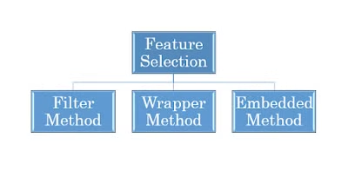
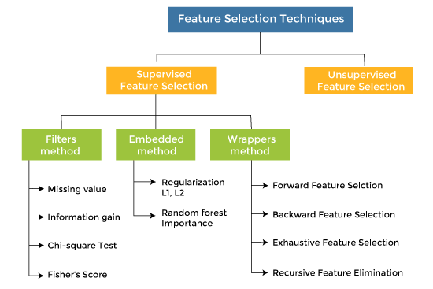
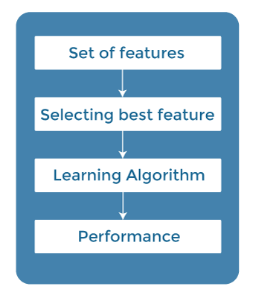
Feature selection Methods
Filter method
Do in the pre-processing step.
they are very fast and inexpensive .
They are very good for removing duplicated, correlated, redundant features but these methods do not remove multicollinearity.
The filter method filters out the irrelevant feature and redundant columns from the dataset by using different metrics
Steps

Slide 5

Filter method techniques
Missing values: Some feature selection methods can handle missing data by ignoring it, imputing it, or using it as a feature. For example, filter methods can ignore missing data by computing statistics only on the available data, or impute it by replacing it with some value, such as the mean, median, or mode
Information Gain – It is defined as the amount of information provided by the feature for identifying the target value and measures reduction in the entropy values. Information gain of each attribute is calculated considering the target values for feature selection.
Chi-square test — Chi-square method (X2) is generally used to test the relationship between categorical variables. It compares the observed values from different attributes of the dataset to its expected value.

Slide 6
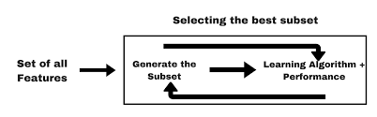
2. Wrapper Methods
Wrapper methods, also referred to as greedy algorithms train the algorithm by using a subset of features in an iterative manner.
Based on the conclusions made from training in prior to the model, addition and removal of features takes place.
The main advantage of wrapper methods over the filter methods is that they provide an optimal set of features for training the model, thus resulting in better accuracy than the filter methods
computationally more expensive.

Slide 7
Forward selection – This method is an iterative approach where we initially start with an empty set of features and keep adding a feature which best improves our model after each iteration. The stopping criterion is till the addition of a new variable does not improve the performance of the model.
Backward elimination – This method is also an iterative approach where we initially start with all features and after each iteration, we remove the least significant feature. The stopping criterion is till no improvement in the performance of the model is observed after the feature is removed.
Bi-directional elimination – This method uses both forward selection and backward elimination technique simultaneously to reach one unique solution.

Slide 8
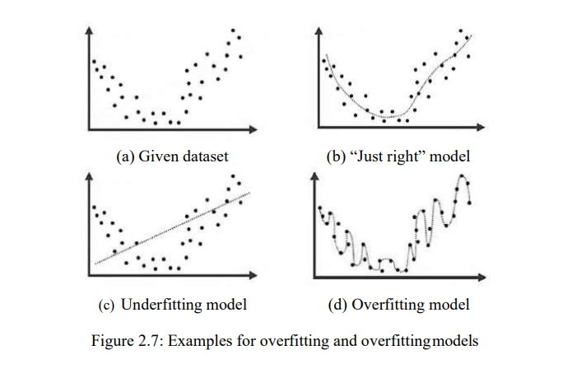
Over fitting , Under fitting
under-fitted,
it cannot identify the dominating trend in the data, resulting in training mistakes and poor model performance (testing error is high)
Overfitting:
In Training the model shows good accuracy and in testing the model shows poor accuracy

Slide 9
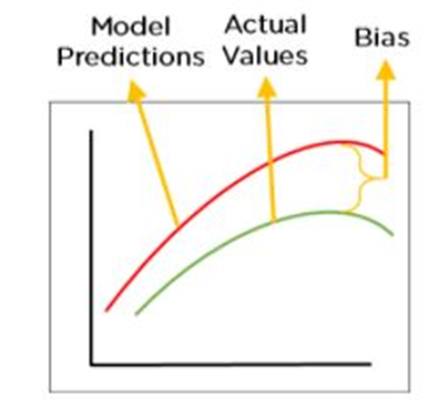
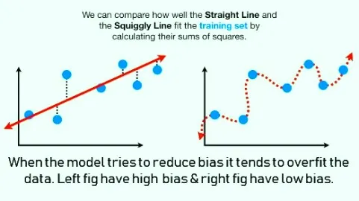
High Bias and low Bias
The bias is known as the difference between the predicted values and actual values of ML model.
High Bias→ Underfitting

Slide 10
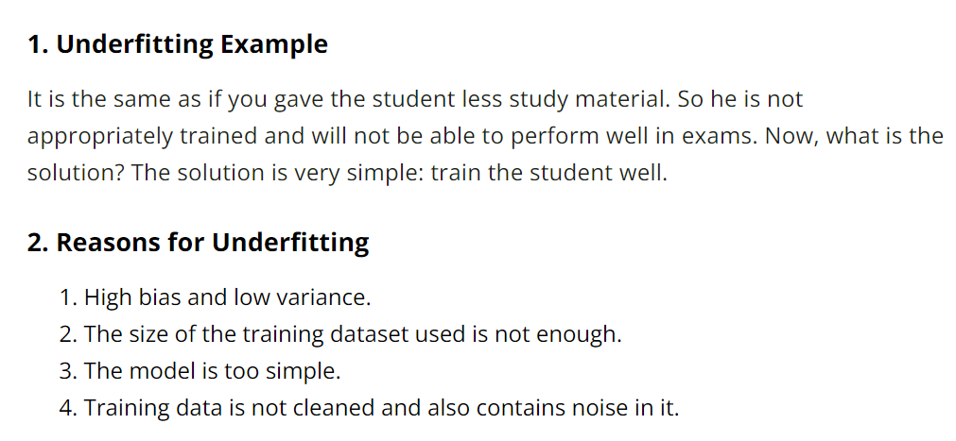
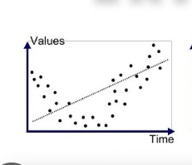
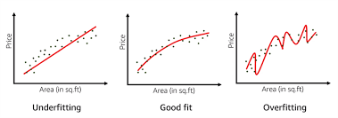
What is a Good Fit in Machine Learning?
A good fit model is a well-balanced model that is free of underfitting and overfitting.
This excellent model provides a high accuracy score during training and performs well during testing.

Slide 11
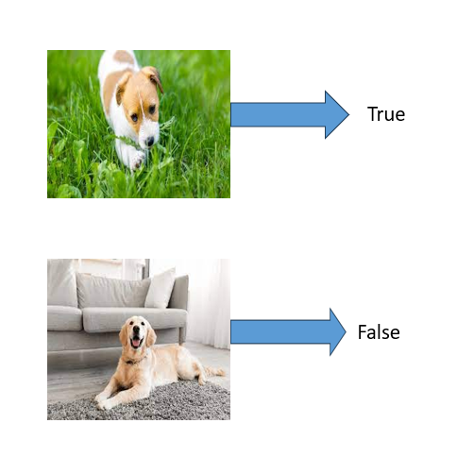
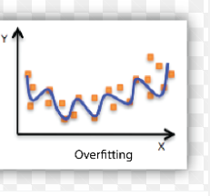
Why overfitting?
The training data size is too small and does not contain enough data samples to accurately represent all possible input data values.
The training data contains large amounts of irrelevant information, called noisy data.
• The model trains for too long on a single sample set of data.
• The model complexity is high, so it learns the noise within the training data.
Overfitting example
Consider a use case where a machine learning model has to analyze photos and identify the ones that contain dogs in them.
If the machine learning model was trained on a data set that contained majority photos showing dogs outside in parks , it may may learn to use grass as a feature for classification, and may not recognize a dog inside a room.

Slide 12
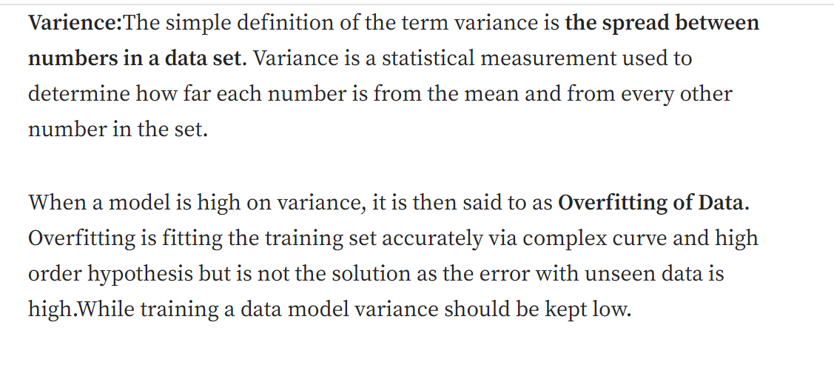
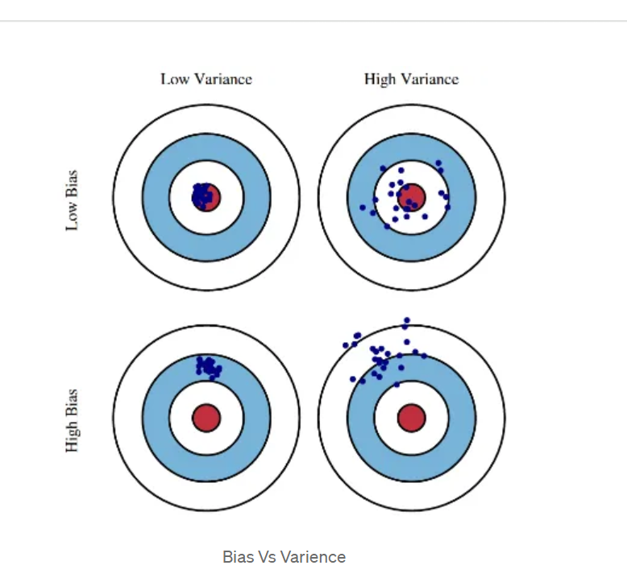
overfitting is you memorise 10 qns for your exam and on the next day exam, only one question has been asked in the question paper from that 10 you read. Now you will answer that one qn correctly just like in the book, but you have no idea what the remaining questions are(Question are HIGHLY VARIED from what you read). In overfitting, model will memorise the entire train data such that it will give high accuracy on train but will suck in test.

Slide 13
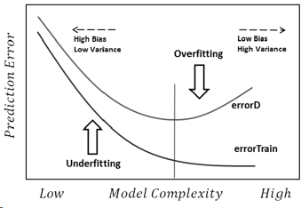
optimum model is in between underfitting and over fitting

Slide 14
How to prevent overfitting
1. Hold-out
2. Cross-validation
3. Data augmentation
4. Feature selection
5. L1 / L2 regularization
6. Remove layers / number of units per layer
7. Dropout
8. Early stopping

Slide 15
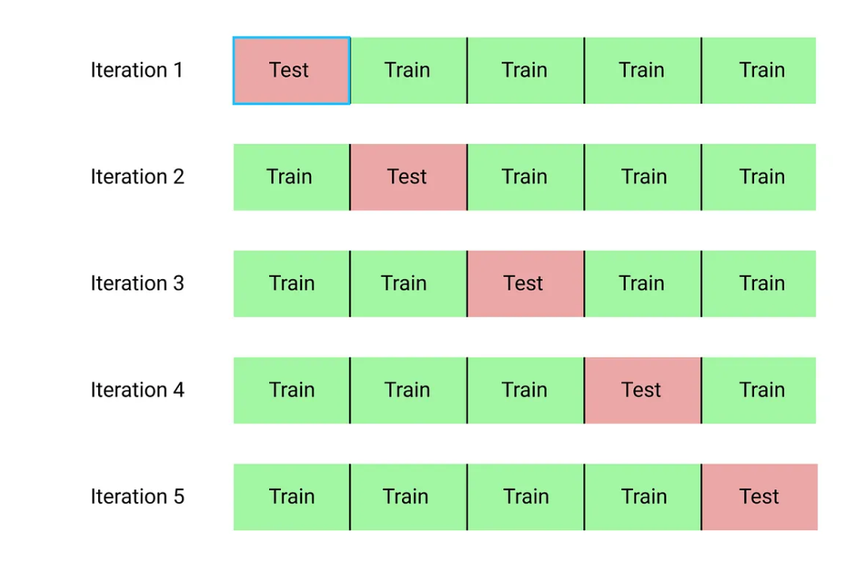
Cross validation

Slide 16
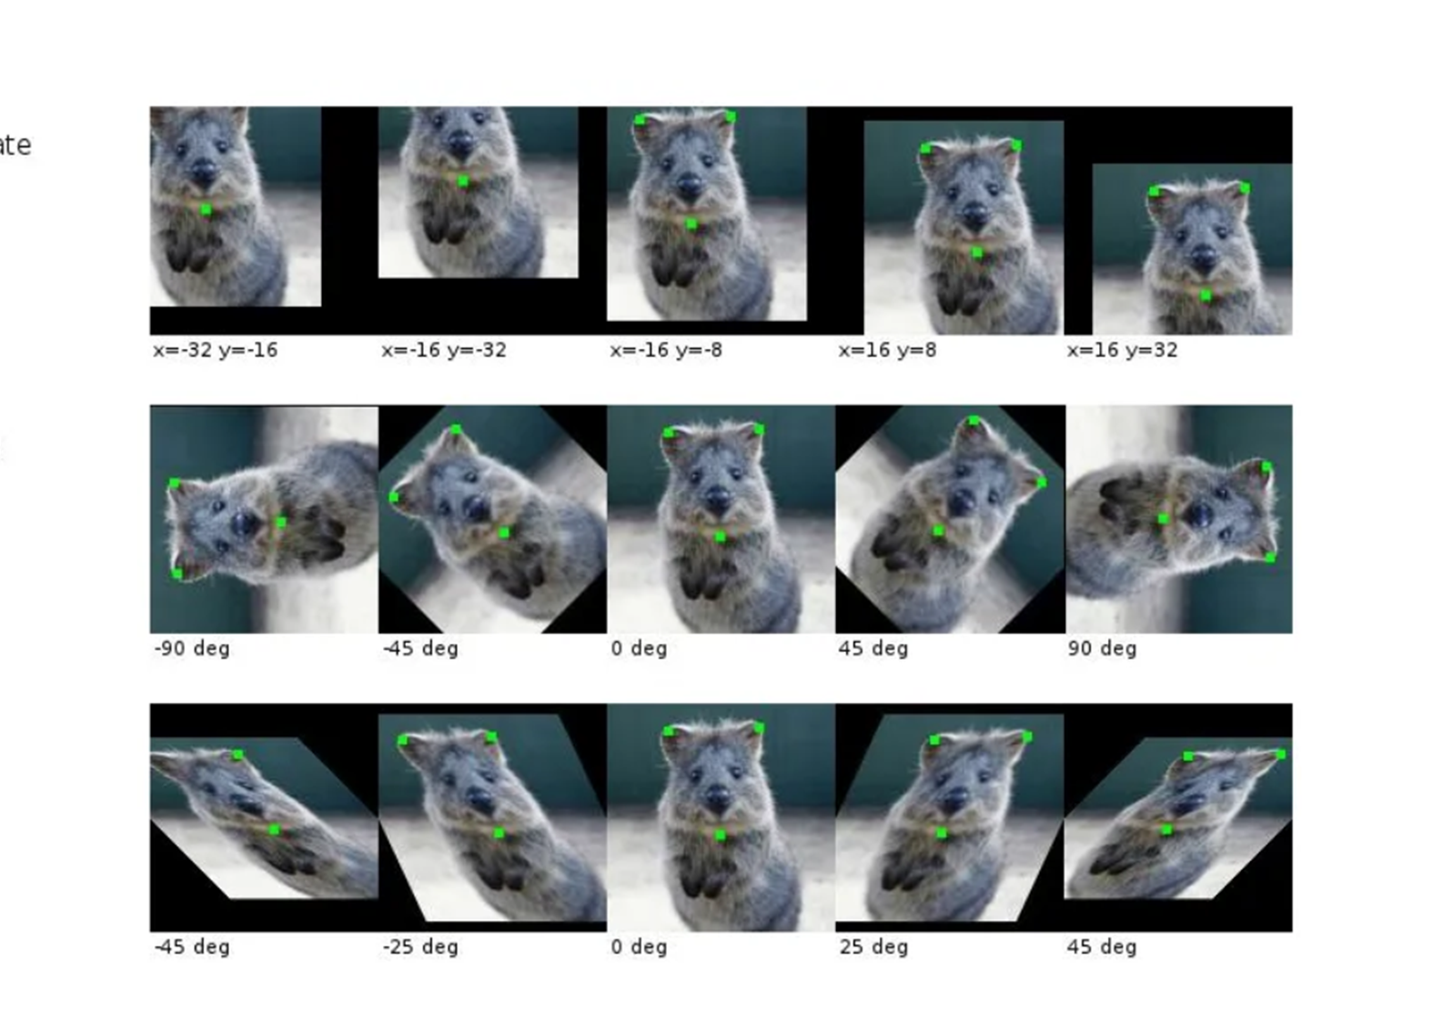
Data augmentation

Slide 17
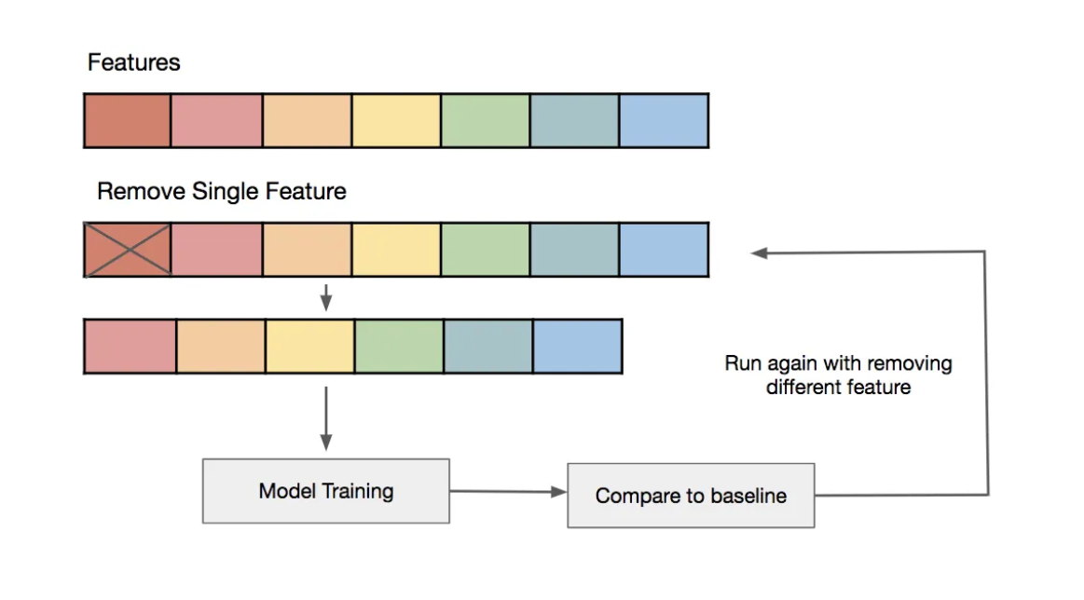
Feature selection

Slide 18
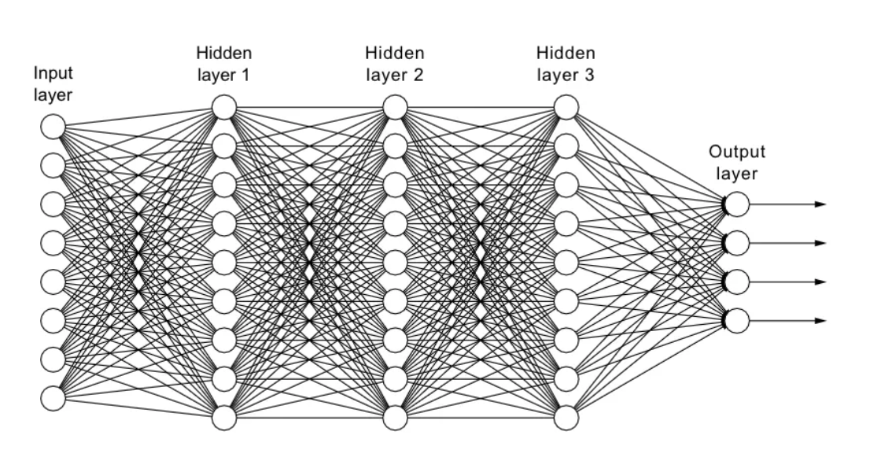
Remove layers

Slide 19
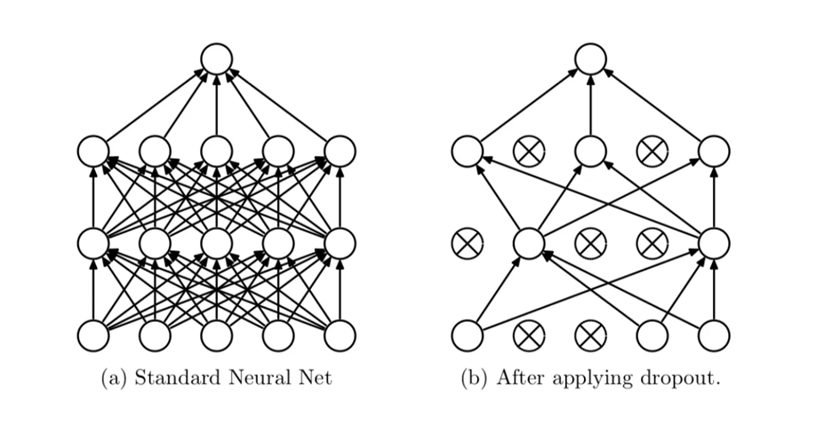
Drop out

